Slide 1
Simple Solution. Brighter Futures.
Class Roster
Refresher Training
January 14, 2020
Texas Education Agency
Notes:
In today’s session, we are going to review what we discussed during the TSDS Class Roster New User Certification Training back in April.
We will go over some of the new updates impacting the Winter submission as a result of the Teachers Incentive Allotment (HB3).
We will also review each of the TSDS Class Roster reports and go over some of the changes to the reports.
Documents for the webinar have been posted to the workshop. PPT, CR Q&A

Slide 2
Course Objectives
The participant will be able to:
  Describe the Class Roster objectives and purpose,
  Describe the Class Roster data elements and interchanges, and
  Describe the TSDS reports for Class Roster.
  Reminders
Notes:
The participant will be able to:
Describe the Class Roster objectives and purpose,
Describe the Class Roster data elements and interchanges, and
Describe the TSDS reports for Class Roster.

Slide 3
Course Agenda
Class Roster Collection (Review)
    Class Roster Overview
    2019-2020 Class Roster Collection Timeline
    TSDS Interchanges for Class Roster
    Impact to PEIMS Summer submission
    TSDS data elements replacing PEIMS data elements
    Class Roster Data Flow Overview
    TEAL Roles for Class Roster
Class Roster Reports (New)
Class Roster (Demo)
Resources and Wrap Up
Questions
Notes:
Review Course Agenda
Items under bullet 1, were reviewed in our class roster early warning in our last big meeting.
Bullet 2. New content will be mockup of CR reports, they have been developed and what data to verify on the report.
3. Demo

Slide 4
Class roster collection (Review)
Notes:
Let’s start by reviewing what we discussed back in April during the Class Roster New User Certification Training.

Slide 5

Class roster overview
As a result of the Sunset review findings, TEA has changed the timings of when Class Roster information is collected by adding a new TSDS Core collection, the TSDS Class Roster collection, to be submitted by LEAs two times per year.
The TSDS Class Roster collection will allow TEA to provide the assessment vendor with Fall class roster information in advance of the End of Course (EOC) assessments which occur in December, and Winter class roster information in advance of STAAR and EOC assessments occurring in May.
The TSDS Class Roster collection will provide the assessment vendor the information required to link a student’s assessment results to the teacher who provided the associated instruction.
The TSDS Class Roster collection will help provide teachers and principals assessment data via the Assessment portal.
Notes:
Currently, the timeframe in which we we’re collecting the Class Roster information isn’t very useful to the current assessment vendor, that’s why we are moving the Class Roster data from the PEIMS Summer submission to its own separate collection.
TEA has changed the timings of when Class Roster information is collected by adding a new TSDS Core Collection, the TSDS Class Roster collection, to be submitted by LEAs two times per year.
The TSDS Class Roster collection will allow TEA to provide the assessment vendor with Fall class roster information in advance of the End of Course (EOC) assessments which occur in December, and a Winter class roster in advance of STARR and EOC assessments occurring in May. Reason for moving from summer to separate submission
The TSDS Class Roster collection will provide the assessment vendor the information required to link a student’s assessment results to the teacher who provided the associated instruction.
The TSDS Class Roster collection will help provide teachers and principals assessment data via the Assessment portal.
Teachers will be able to view individual assessment results for their students. Same is true for administrator, they will be able to see assessment results for their campuses, enabling them to more easily develop strategies for improving student outcomes.

Slide 6
2019-2020 Class Roster Collection timeline
 | Class Roster Fall Submission | Class Roster Winter Submission*
As of: | The last Friday in September. | The last Friday in February.
Data due by: | October 17, 2019 | March 19, 2020
Information to be included:
Organization | LEA and Campus
Course section data | Teachers teaching a course section for grades 1-12. Students enrolled in a course section for grades 1-12. | Teachers teaching a course section for grades EE-12. Students enrolled in a course section for grades EE-12.
Staff (Teacher of Record & Substitute teachers) | Identification, demographic and class assignment.
Student | Identification, demographic and class enrollment.
*To accurately identify all districts with teachers eligible for funds under the Teacher Incentive Allotment, the Class Roster Winter Submission will include the collection of class roster information for the grade levels of early education (EE), prekindergarten (PK) and kindergarten (KG).
Notes:
The Class Roster collection will have two submissions per school year, Fall and Winter.
This collection includes organization, staff identification and demographics, class assignment, student identification and demographics, and class enrollment data. (Review details outlined in the slide.)
NOTE: For the 2019-2020 school year, LEAs will not submit data for the Fall Submission.
Refer to the TAA Letter for more information.
*Under HB 3, a Teacher Incentive Allotment was established to provide additional funding for high needs and rural districts to provide additional compensation to master, exemplary and recognized teachers serving in these districts. To accurately identify all districts with teachers eligible for funds under the Teacher Incentive Allotment, TEA has determined it is necessary to expand the Class Roster Winter Submission to include the collection of class roster information for the grade levels of early education (EE), prekindergarten (PK) and kindergarten (KG).
(Fall submission we will collect all service ID’s for grades 1-12. For Winter submission we will collect all service ID’s for all grade levels. Do not include courses with SERVICE-IDs that begin with “SA”, “SE”, “SR”, “SS”, or “8”. You will get a Fatal warning.
Classroom Roster Fall Submission
Only staff serving an LEA as of the last Friday in September who have a ROLE-ID 087 (Teacher) or ROLE-ID 047 (Long-term Substitute Teacher) and CLASSROOM-POSITION-TYPE of 01 (Teacher of Record) should be reported.
Classroom Roster Winter Submission
Only staff serving an LEA as of the last Friday in February who have a ROLE-ID 087 (Teacher) or ROLE-ID 047 (Long-term Substitute Teacher) and CLASSROOM-POSITION-TYPE of 01 (Teacher of Record) should be reported.
Class Roster Fall Submission:
Students enrolled in the LEA in grades 1-12 as of the last Friday in September should be reported as part of the Class Roster Fall Submission.
Class Roster Winter Submission:
Students enrolled in the LEA in grades EE-12 as of the last Friday in February should be reported as part of the Class Roster Winter Submission.
(Students that enrolled or withdrew after the snapshot date, that information will not be in the Class Roster submission. Assessment vendors may not be able to link those students to the assessments. We understand the class roster could change after those snapshot dates, but that’s the closest we could get it to providing near real time data to the assessment vendors.)
TEDS has been updated to include grades EE, PK, KG in the Class Roster Winter Submission. Class Roster Winter Submission reports will include grades EE, PK and KG data.

Slide 7
TSDS interchanges for Class Roster
Category | Complex Type | TSDS Interchanges
Education Organization | LocalEducationAgencyExtension SchoolExtension Course | InterchangeEducationOrganizationExtension
Campus Course Section | CourseOffering SectionExtension | InterchangeMasterScheduleExtension
Student | StudentExtension | InterchangeStudentParentExtension
 | StudentSectionAssociation StudentSchoolAssociationExtension | InterchangeStudentEnrollmentExtension
Staff | StaffExtension TeacherSectionAssociationExtension | InterchangeStaffAssociationExtension
Notes:
Here is a list of the Interchanges that you guys will need to load in this order into the TSDS edm application ( looks like 4 files).
Here’s a list of all the complex types by TSDS interchange that need to be loaded into ODS for the Class Roster collection.
Refer to TSDS Web-Enabled Data Standards (TWEDS) for more information.
Reminder: Load Class Roster interchange files into the ODS using the TSDS collection and not the TSDS PEIMS SUMR collection.

Slide 8
Impact to PEIMS summer submission
Complex Type | Impact to PEIMS Summer Submission
LocalEducationAgencyExtension | No change
SchoolExtension | No change
CourseOffering | Reduce collection to only high school courses, and courses taken via the TxVSN Online Schools program and the TxVSN Statewide Online Course Catalog.
SectionExtension
StaffExtension | No longer collected
StaffEducationOrgEmploymentAssociationExtension
TeacherSectionAssociationExtension
StudentExtension | No change
StudentSectionAssociation | Reduce the collection of data to only where the COURSE-COMPLETION-INDICATOR is “1” (completed) for all high school courses, and all courses completed via the TxVSN Online Schools program (grade levels 3 - 12) and the TxVSN Statewide Online Course Catalog (grade levels 9 – 12).
Notes:
Since we’re moving the Class Roster data from PEIMS to TSDS, there will be impact to the PEIMS Summer submission. Here’s the impact. (Review the slide.)
In PEIMS Summer submission, the Couse Offering and Section Extension complex types will be modified.
TEA will only collect:
all high school courses,
all courses via the TxVSN Online Schools program (grade levels 3 – 12), and
all courses via the TxVSN Statewide Online Course Catalog (grade levels 9 – 12).
Eliminate of the collection of non-high school course and section information except for certain TxVSN courses as described above.
These Staff complex types will no longer be collected in the PEIMS Summer Submission.
StaffExtension
StaffEducationOrgEmploymentAssociationExtension
TeacherSectionAssociationExtension
Only collect the StudentSectionAssociation Complex Type where the COURSE-COMPLETION-INDICATOR is “1” (completed) for the following:
all high school courses,
all courses completed via the TxVSN Online Schools program (grade levels 3 - 12), and
all courses completed via the TxVSN Statewide Online Course Catalog (grade levels 9 – 12).
Eliminate of the collection of non-high student transcript information except for certain TxVSN courses as described above.
Eliminate the collection of course attempts that are incomplete (COURSE-COMPLETION-INDICATOR of “0”).

Slide 9
TSDS data elements replacing PEIMS data elements
Complex Type: | Prior PEIMS data element used: | Now using TSDS data element:
SectionExtension | POPULATION-SERVED-CODE (E0747) | POPULATION-SERVED (E1362)
StaffExtension StudentExtension | GENERATION-CODE (E0706) SEX-CODE (E0004) HISPANIC-LATINO-CODE (E1064) AMERICAN-INDIAN-ALASKA-NATIVE-CODE (E1059) ASIAN-CODE (E1060) BLACK-AFRICAN AMERICAN-CODE (E1061) NATIVE-HAWAIIAN-PACIFIC-ISLANDER-CODE (E1062) WHITE-CODE (E1063) | GENERATION-CODE-SUFFIX (E1303) SEX (E1325) HISPANIC-LATINO-ETHNICITY (E1375) RACIAL-CATEGORY (E1343)
StaffExtension | HIGHEST-DEGREE-LEVEL-CODE (E0730) YEARS-EXPERIENCE-IN-DISTRICT (E0161) TOTAL-YEARS-PROF-EXPERIENCE (E0130) | HIGHEST-LEVEL-OF-EDUCATION-COMPLETED (E1460) YEARS-OF-PRIOR-TEACHING-EXPERIENCE (E1377)
TeacherSection AssociationExtension | CLASS-ROLE (E1067) | CLASSROOM-POSITION (E1454)
StudentSchoolAssociationExtension | GRADE-LEVEL-CODE (E0017) | ENTRY-GRADE-LEVEL-TYPE (E1517)
Notes:
This table shows the TSDS data elements that will be used instead of the PEIMS data elements.
The PEIMS data elements use code values whereas the LEAs will need to enter a description for the TSDS data elements.
EX: Population Served in PEIMS is 01, in (TSDS data element)CR Population Served would be the description “regular student” (E1362).
Reason for change in coding is as you are loading your file into the edm you might get errors, it is highly recommended to use the Client Side Validation Tool to check the data integrity.

Slide 10
Class roster data flow overview
Notes:
The data collection process is the same as any other TSDS Core Collections (ECDS, SPPI-14 & RFT). TEA envisions this submission as a 2-part process with responsibilities shared between the LEA TSDS Technical Data Loader and the LEA PEIMS Coordinator.
Technical data loading staff at the LEA will extract the data from the SIS and load into the ODS for all collections, validate the data, and then verify that the data loaded into the ODS.
PEIMS Coordinator will then promote the data which will pull the data from the ODS into the applicable Data Mart where the submission will be validated, reports checked, and completed.
LEAs can start promoting Class Roster Winter submission on January 27, 2020 into the TSDS Core Collection application.

Slide 11
TEAL Roles for class roster
Class LEA Data Viewer
  This role cannot edit data. This role can monitor data promotions and data validations and generate reports.
Class LEA Data Promoter
  This role initiates the promotion which will move the data from the ODS. This role can schedule and monitor promotions, schedule and monitor validations, and generate reports.
Class LEA Data Completer
  This role formally certifies the completeness and accuracy of their data and finalizes the collection. In addition, this role can also schedule and monitor promotions, schedule and monitor validations, and generate reports.
Class LEA Data Approver
  This role is generally for the Approver at the LEA. The role will allow the LEA to request an extension for the Class Roster collection in extreme situations.
  Class ESC Data Viewer
  This role will allow the ESCs to monitor promotions and validations for their LEAs and view
  reports.
Notes:
These are the TEAL roles for Class Roster at the LEA who will promote, validate and complete the Class Roster collection.
The person designated to promote/validate the data will request the Class Roster Data Promoter role. Need! Cannot Complete!
The person designated to complete the data will request the Class Roster Data Completer role. Need!
The person designated to request extensions for the Class Roster data collection will request the Class Roster Data Approver role. Super or designee Needs!
The person designated to only view the reports will request the Class Roster Data Viewer role.
The ESC staff person designated to monitor or view the LEA Class Roster data collection will request the Class Roster ESC Data Viewer.
Class Roster roles are in production. LEAs can start requesting them to begin working on their Class Roster Winter submission.
Note, users will also need to request the ODS Data Loader role to load the TSDS Class Roster interchange files into the ODS. Needed!
Note: Your district will not get an email that the TSDS submission has been completed (such as in PEIMS), TEA did mention that
that functionality is being planned for in the TSDS Core Collections. NO ETA

Slide 12
Class roster reports (New)

Slide 13
TSDS Class Roster reports
TSDS Class Roster Report # | TSDS Class Roster Report Name | TSDS PEIMS Legacy Report # | TSDS PEIMS Legacy Report Name
CLS1-100-001 CLS2-100-001 | Student Class Roster | PDM3-112-001 | Class Roster*
CLS1-100-002 CLS2-100-002 | Student Class Schedule | PDM3-113-001 | Student Class Schedule*
CLS1-100-003 CLS2-100-003 | Staff Class Assignment | PDM3-114-002 | Staff Class Assignment**
CLS1-100-004 CLS2-100-004 | Teacher Class Summary | PDM3-114-001 | Teacher Class Summary**
CLS1-100-005 CLS2-100-005 | Staff Roster | PDM3-111-005 | Staff Roster**
CLS1-100-006 CLS2-100-006 | Submission Summary | PDM3-230-002 | Submission Summary*
*Remain in TSDS PEIMS SUMR
**Removed from TSDS PEIMS SUMR
Notes:
There are a total of 6 reports for each submission (Fall- CLS1 & Winter- CLS2). Shown here are the TSDS Class Roster reports with their respective TSDS PEIMS legacy reports.
The TSDS Class Roster reports will be very similar (replicas) to the Classroom link reports in TSDS PEIMS.
Prior year data will not be migrated from TSDS PEIMS to the Class Roster collection.
*These reports will remain in TSDS PEIMS SUMR
**These reports will be removed from TSDS PEIMS SUMR

Slide 14
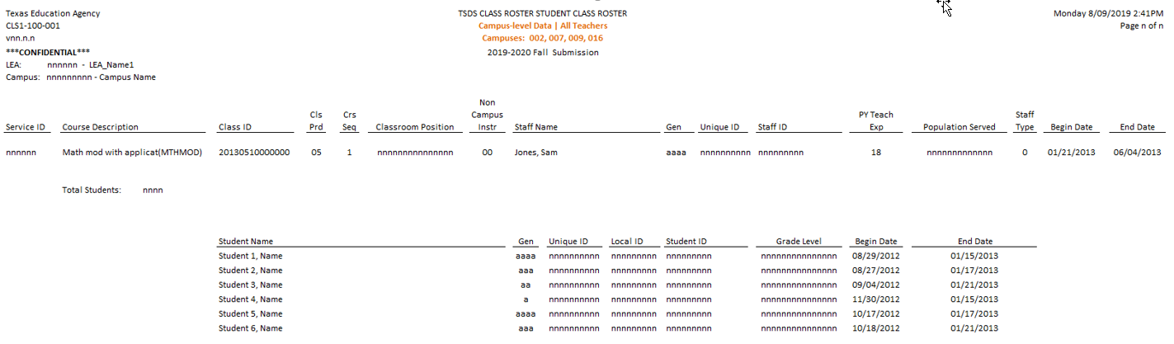
STUDENT CLASS ROSTER report
(TSDS PEIMS Legacy Report #: PDM3-112-001)
‘Total Yrs. Exp.’
  This report lists class and teacher information, including a list of students attending each class.
  LEAs should verify the data they have submitted for each teacher’s Service IDs.
  Twin Report: CLS2-100-001(Winter Submission)
  Report PDM3-112-001will remain in PEIMS SUMR submission but the report will no longer show staff information. (Red box)
Notes:
(Review slide)
-----
TSDS Class Roster Report:
The Student Class Roster Report in the TSDS Class Roster collection will be very similar to the Class Roster report you are use to seeing in TSDS PEIMS SUMR submission.
The TSDS Student Class Roster Report will have ‘Classroom Position’ instead of ‘Class Role’ & ‘PY Teach. Exp.’ instead of ‘Total Yrs. Exp.’ This is because we are replacing TSDS PEIMS data elements with TSDS data elements.
Verify: Report contains information on the teachers class and a list of the students in that class.
The data that needs to be verified is: are you using the right service id? Is that the right teacher?
Make sure the begin and end dates are correct.
PY Teach is used to be Total Yrs Experience, now they are using PY teach exp to identify first – three yr teachers experience.
IMPACT TO TSDS PEIMS SUMR REPORT:
Report PDM3-112-001 will remain in PEIMS SUMR but the report will no longer show Staff information because staff is no longer collected in PEIMS SUMR. (Red box)
TSDS PEIMS reports will only reflect course completion data as that is all that is collected in the Summer now.'

Slide 15
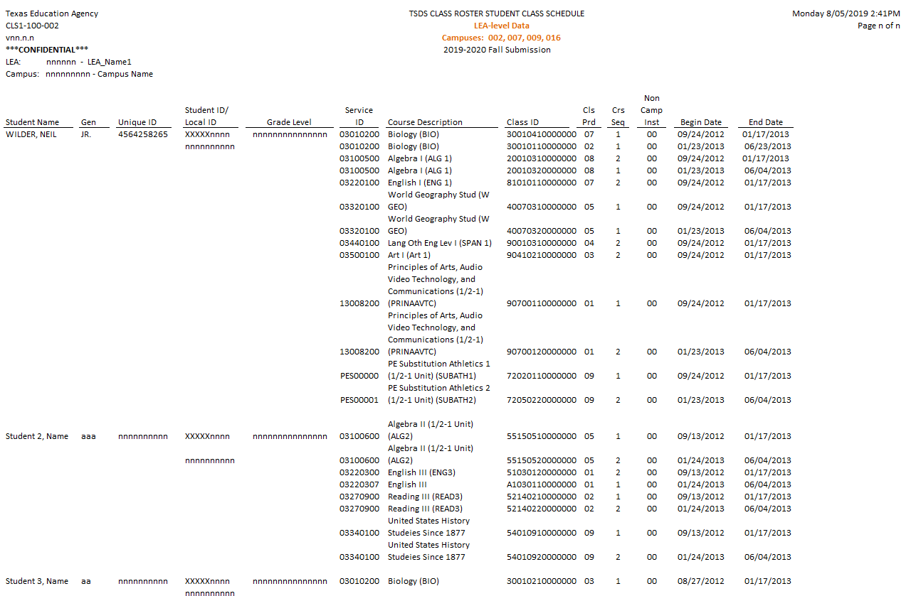
STUDENT CLASS schedule report
(TSDS PEIMS Legacy Report #: PDM3-113-001)
  This report will provide a listing of students with their class assignment schedules and class attributes.
  LEAs should verify the data they have submitted for each student’s class schedule.
  Twin Report: CLS2-100-002 (Winter submission)
  Report PDM3-113-001will remain in PEIMS SUMR submission.
Notes:
(Review slide)
-----
TSDS Class Roster Report:
The Student Class Schedule Report in the TSDS Class Roster collection will be very similar to the Student Class Schedule report you are use to seeing in TSDS PEIMS SUMR submission.
The TSDS Student Class Schedule Report will not show the course completion indicator, pass/fail indicator code, and the pass/fail credit indicator.
IMPACT TO TSDS PEIMS SUMR REPORT:
No changes to the TSDS PEIMS PDM3-113-001 report. TSDS PEIMS PDM3-113-001 will continue to show the course completion indicator, pass/fail indicator code, and the pass/fail credit indicator for all high school courses, and all courses completed via the TxVSN Online Schools program (grade levels 3 - 12) and the TxVSN Statewide Online Course Catalog (grade levels 9 – 12.)

Slide 16
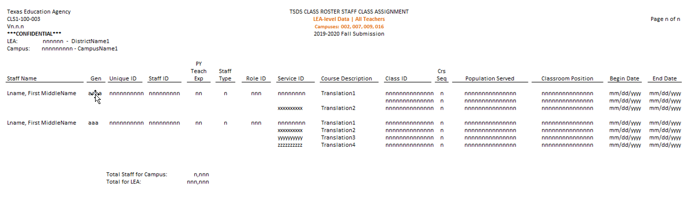
Staff class assignment report
(TSDS PEIMS Legacy Report #: PDM3-114-002)
  This report lists the staff arranged alphabetically along with classroom attributes.
  Report can be generated on all teachers or only beginning teachers.
  Twin: CLS2-100-003 (Winter Submission)
  Report PDM3-114-002 has been removed from PEIMS SUMR submission.
Notes:
TSDS Class Roster Report:
The Staff Class Assignment Report in the TSDS Class Roster collection will have ‘PY Teach Exp.’ instead of ‘Total Years Exp.’ & ‘Classroom Position’ instead of ‘Class Role’.
Make sure all staff are listed, Role id 087/047, if not there they might not be scheduled, or your SIS is not extracting them. Go thru columns.
Begin date is mandatory, end date can be blank.
Classroom Position= (E1454)The type of position the staff member holds in the specific class/section; for example: Teacher of Record, Assistant Teacher, Support Teacher, Substitute Teacher. Not mandatory.
IMPACT TO TSDS PEIMS SUMR REPORT:
TSDS PEIMS Legacy Report #: PDM3-114-002 has been removed from PEIMS SUMR submission.

Slide 17
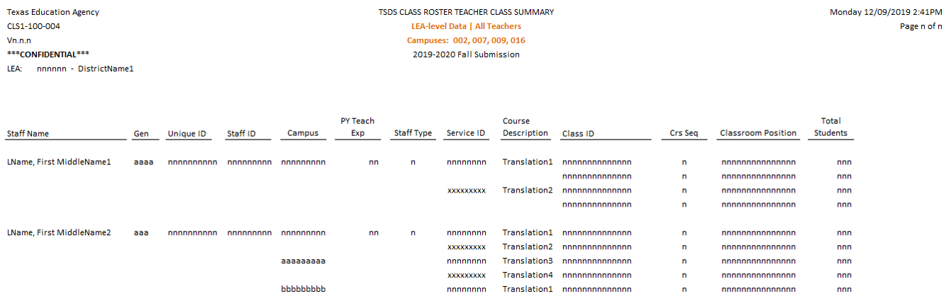
Teacher class summary report
(TSDS PEIMS Legacy Report #: PDM3-114-001)
  This report summarizes teacher and class information for grades 1-12 for Fall submission and all grades levels for Winter submission, including student counts.
  Twin: CLS2-100-004 (Winter Submission)
  Report PDM3-114-001 has been removed from PEIMS SUMR submission.
Notes:
(Review slide)
-----
TSDS Class Roster Report:
The TSDS Teacher Class Summary report in the TSDS Class Roster collection will have ‘PY Teach. Exp.’ instead of ‘Years Exp.’ & ‘Classroom Position’ instead of ‘Class Role’.
This report will not show the Total Incomplete indicator code, Total Pass indicator code and Total Fail indicator code.
IMPACT TO TSDS PEIMS SUMR REPORT:
Report PDM3-114-001 has been removed from PEIMS SUMR submission.

Slide 18
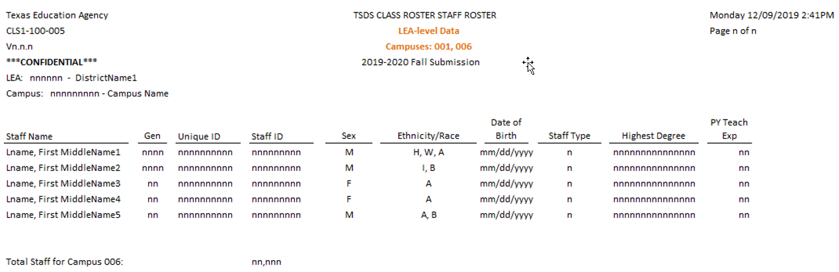
Staff roster report
(TSDS PEIMS Legacy Report #: PDM3-111-005)
  This report provides a staff roster listing and summarizes individual staff profiles in alphabetical order by last name.
  LEAs should verify the data they have submitted for each staff member.
  Twin: CLS2-100-005 (Winter Submission)
  Report PDM3-111-005 has been removed from PEIMS SUMR submission.
Notes:
(Review slide)
-----
TSDS Class Roster Report:
The TSDS Staff Roster Report in the TSDS Class Roster collection will have ‘PY Years Exp.’ instead of ‘Yrs. Exp.’
This report will not show the following fields that were on the TSDS PEIMS Staff Roster report:
(highlighted in yellow)
Experience LEA - Number of years of experience of the staff member in the current LEA.
# Days Employed - Number of at-work days within the school year that the employee is scheduled to work in the LEA.
% Day Employed - Percentage of standard LEA workday for which the employee is hired to work.
Staff-Type (E1454) indicates whether the staff person is on the district payroll or is a contracted professional staff person (instructional and non-instructional)
IMPACT TO TSDS PEIMS SUMR REPORT:
Report PDM3-111-005 has been removed from PEIMS SUMR submission. No more staff in PEIMS summer.

Slide 19
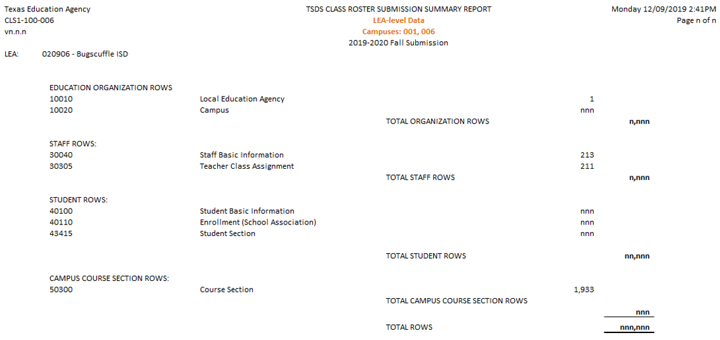
Submission summary report
(TSDS PEIMS Legacy Report #: PDM3-230-002)
  This report displays row counts by category and subcategory.
  Twin Report: CLS2-100-006 (Winter Submission)
  Report PDM3-230-002 will remain in PEIMS SUMR submission but the report will no longer show staff information. (Red box)
Notes:
(Review slide)
-----
TSDS Class Roster Report:
The TSDS Submission Summary Report in the TSDS Class Roster collection will display row counts by category and subcategory, including those with no data.
IMPACT TO TSDS PEIMS SUMR REPORT:
Report PDM3-230-002 will remain in PEIMS SUMR but the report will no longer show Staff category and subcategories because staff is no longer collected in PEIMS SUMR. (Red box)
TSDS PEIMS reports will only reflect course completion data as that is all that is collected in the Summer now.

Slide 20
Class Roster Process

Slide 21
Class roster (Process)
Obtain files from you SIS
Run Files Thru CVT
Interchange Upload in EDM
Batch
Stop-Go to Core Collections Class Roster
In Core Collection:
1.Promote
2. Validate
3. Fatal Free
4. Reports
5. Complete
Promote on:
Class Roster
2019-2020
Winter

Slide 22
InterchangeMasterScheduleExtension
Run local District/Campus Master Schedule and verify all sections.
Verify all PEIMS elements with your Campus Administrators.
Look for invalid Service IDs
InterchangeStaffAssociationExtension
Make sure your 087 and 047 are Active in HR.
Have HR check for teachers with no “Days Worked” or “Percent Day Employed”
Make sure all changes in Primary teacher are recorded
Make sure all support and assistant teachers are included in the Master Schedule

Slide 23
Resources and wrap up

Slide 24
Class roster additional Resources
  TAA Letter – June 2019
  TSDSKB-587 - Class Roster: General FAQs for Class Roster Collection
  Delete Utility Reload Guide for TSDS Deletes
  Texas Education Data Standards (TEDS)
  TWEDS
Notes:
NOTE: Prior to running a delete, please communicate with other staff at the LEA who may also be loading for other TSDS collections as this may impact their TSDS collections.

Slide 25
Wrap Up
Today we talked about:
  The purpose of the Class Roster collection,
  Data elements and interchange files for Class Roster,
  The process for loading Class Roster data in the ODS, and
  TSDS reports for Class Roster.

Slide 26

Questions?
For more information visit: www.TexasStudentDataSystem.org
If you have any questions, please create a TIMS ticket.
Notes:
If you have any training related questions, please email the training mailbox at TSDS_training@tea.Texas.gov.
If you have any support related questions on the Class Roster collection, please create a TIMS ticket.
SURVEY: https://tea.co1.qualtrics.com/jfe/form/SV_9pHxpOklib6o32d

